Slide 1
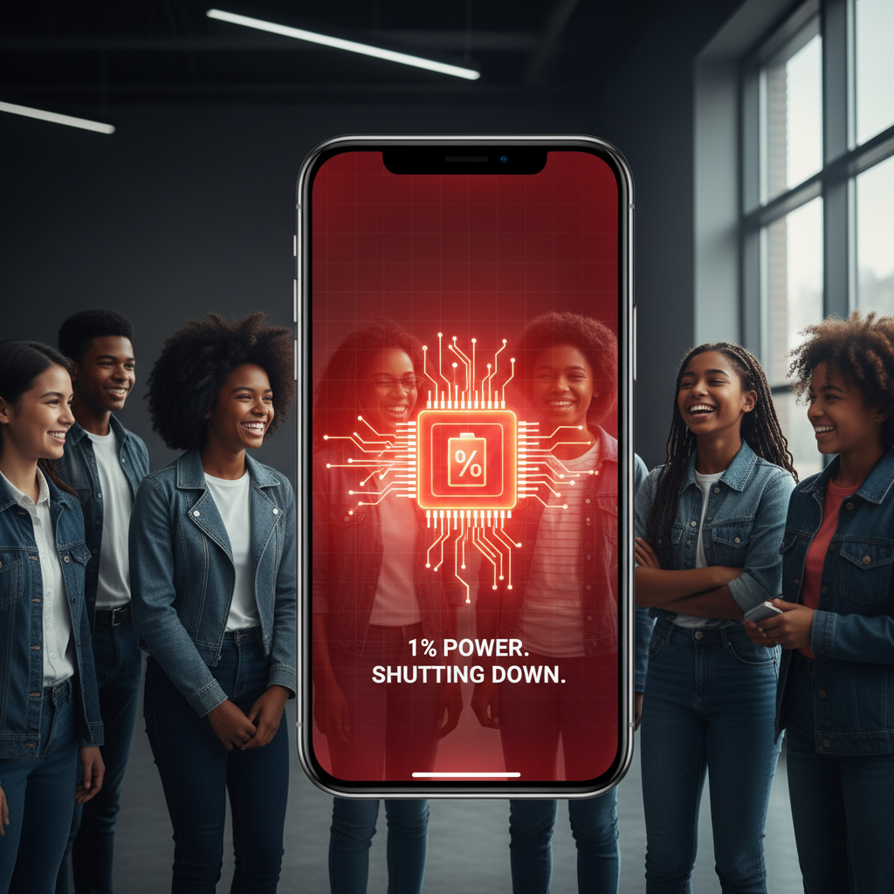
ModelIt!
Student Lesson
Why Your Phone Battery Dies So Fast
Energy Conversion, Efficiency, and the Heat Tax
NGSS: HS-PS3-1, HS-PS3-3
9th Grade — Level 1: Foundations
1/9

Slide 2
What You Will Learn Today
Learning Goals
* Identify the components that consume energy in a mobile device
* Model how energy converts from chemical to electrical to heat
* Explain why energy conversion is never 100% efficient
* Predict battery life under different usage scenarios
Key Vocabulary
Energy Conversion
The process of changing energy from one form to another — e.g., chemical energy in a battery to electrical energy to light from the screen
Thermal Dissipation
Energy lost as heat during any energy conversion process — this is the 'heat tax' you pay every time energy changes form
Power Draw
The rate at which a device consumes energy, measured in watts — higher power draw means faster battery drain
Efficiency
The ratio of useful energy output to total energy input — no device is 100% efficient because some energy always becomes heat
2/9

Slide 3
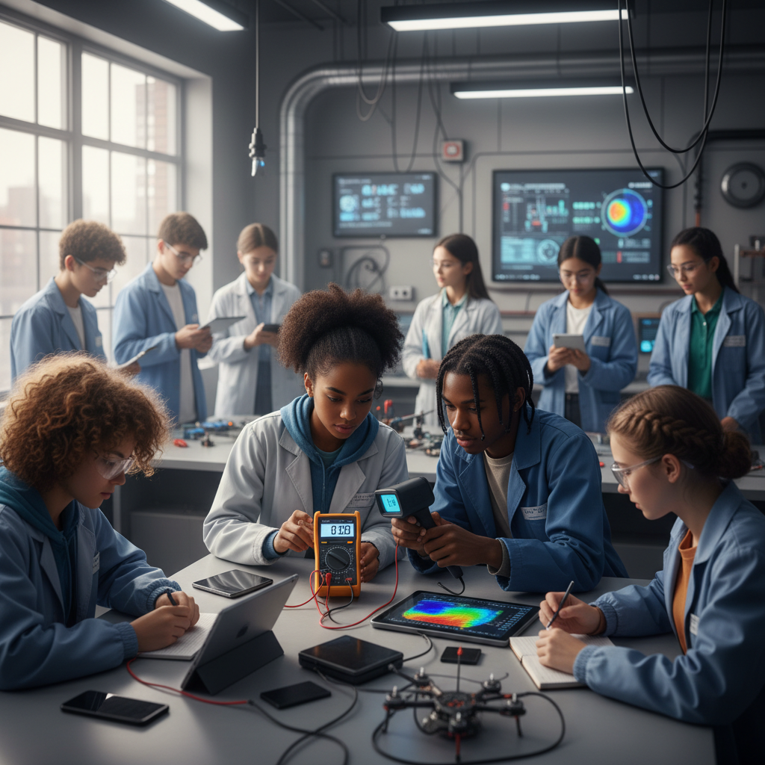
The Big Question
Why does your phone die in 3 hours of gaming but lasts all day on standby?
Energy Conversion, Efficiency, and the Heat Tax. Today we'll build a MODEL to discover the answer!
3/9

Slide 4

Today We Will Build a Model!
A model helps us understand complex systems!
1. LOCATE
Identify the COMPONENTS (parts) of the system
2. ESTABLISH
Connect them with RELATIONSHIPS (+ or -)
3. VISUALIZE
Build your model in ModelIt!
4. EVALUATE
Run SIMULATIONS to test scenarios
5. REVISE
Improve your model based on evidence
4/9

Slide 5
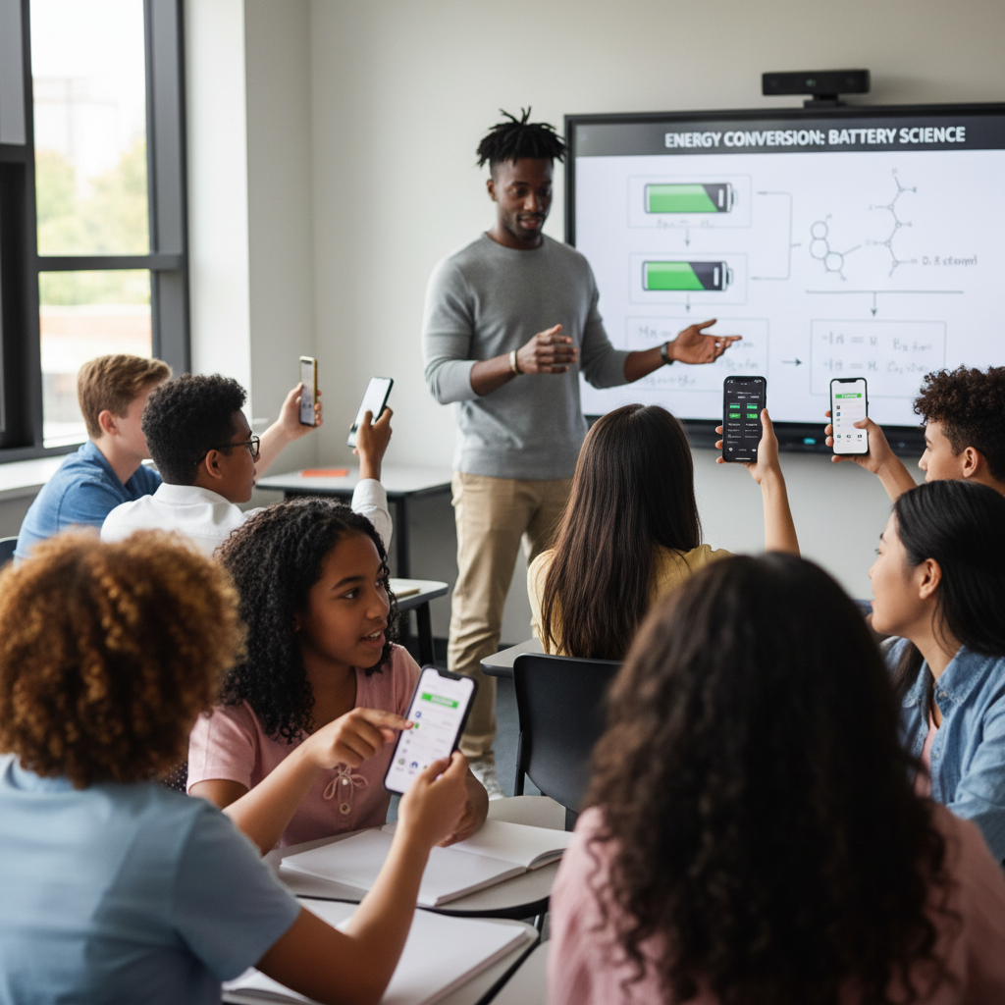
Activity 1: Sort the Components
Sort these components into EXTERNAL (inputs from outside) and INTERNAL (inside the system):
Your Components:
* Screen Brightness
* Processing Load
* Battery Capacity
* Heat Generation
* Battery Life
Think: Which components can we control? Which happen on their own?
5/9

Slide 6
Activity 2: Connect with Arrows
Draw arrows to show HOW components affect each other:
(+) POSITIVE Relationship
When one goes UP, the other goes UP too
(-) NEGATIVE Relationship
When one goes UP, the other goes DOWN
Think About It:
Your phone gets hot when you game. Where is that heat energy coming from — and where was it supposed to go instead?
6/9

Slide 7
Activity 3: Run the Simulation!
Test these scenarios in ModelIt!
Heavy Gaming
Set Screen Brightness to HIGH and Processing Load to HIGH. Observe Battery Life and Heat Generation.
Standby Mode
Set Screen Brightness to LOW and Processing Load to LOW. Compare battery drain to gaming mode.
Brightness Test
Keep Processing Load at MEDIUM but change Screen Brightness from LOW to HIGH. What drains more — screen or processor?
Watch the activity graphs change!
[ModelIt Platform Screenshot - Simulation Results Graph]
7/9

Slide 8
What Did We Discover?
Our Model Showed Us:
* Energy conversion from battery chemical energy to screen light and computation is never 100% efficient
* Heat generation is wasted energy — every watt of heat is a watt NOT powering your screen or apps
* Screen brightness and processing load have a multiplicative effect on battery drain
* Battery capacity degrades over time, meaning the same usage pattern drains faster on an old phone
Answer: Your phone battery dies fast during gaming because both the screen and processor are drawing maximum power simultaneously. Energy converts from chemical (battery) to electrical to light (screen) and computation (CPU), but at every step some energy is lost as heat. Gaming might use 5-8 watts while standby uses 0.1-0.3 watts — a 20-50x difference. That's why 3 hours of gaming equals 24+ hours of standby.
8/9

Slide 9

STEM Challenge: The Battery Optimization Challenge
YOUR ENGINEERING MISSION
Design a power management system that maximizes battery life for a student who needs their phone to last a full school day (8 hours) with moderate use.
The Challenge:
A student's phone has a 4,000 mAh battery. They need to text, check social media during breaks, watch a 30-minute video at lunch, and use GPS to get home. Design power settings that keep the phone alive all day without carrying a charger.
Think Like an Engineer:
* Which energy-consuming components can you reduce without ruining the experience?
* When during the day should you allow high-power activities vs. conserve?
* What's the minimum acceptable brightness and processing for each activity?
REAL CAREER CONNECTION: Electrical Engineers design the power management systems in every device you own. They optimize energy conversion efficiency, design battery charging circuits, and create the algorithms that decide when to throttle performance to save power. The skills you're using TODAY are the same ones they use on the job!
9/9

